Slide 1
Hollybrook Play park consultation
Results

Slide 2
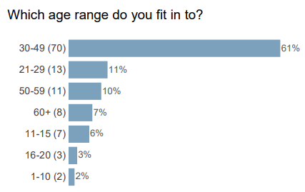
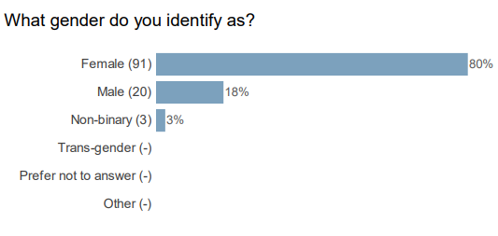
Overall results
The Hollybrook play area consultation started on Tuesday 7th November 2023 and ran for six weeks closing on Tuesday 19th December 2023. The survey received 114 responses.
Results broken down into location
Whitehill & Bordon 102 responses
Lindford 9 responses
Headley 2 responses
Bramshott and Liphook 1 responses
Grayshott 0 responses
Other 0 responses

Slide 3
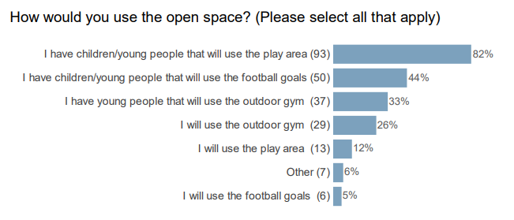
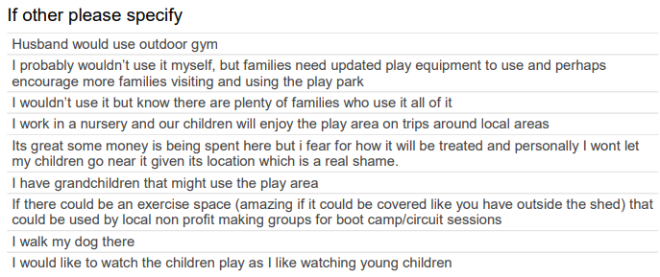
How would you use the open space?

Slide 4
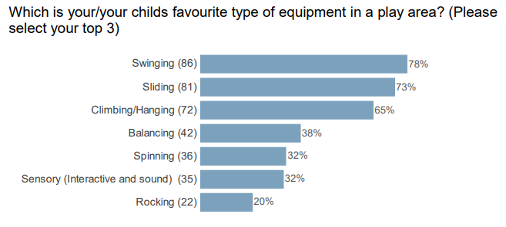
Which is you/your child's favourite type of equipment in a play area

Slide 5
Which is your/your childs favourite type of play?
which is your/your childs favourite type of play?

Slide 6
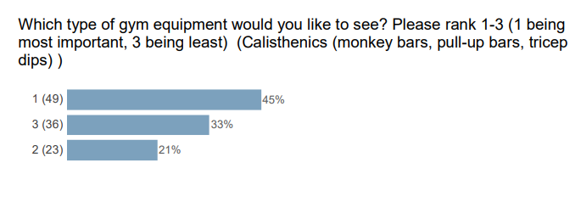
Which is your/your childs favourite type of play?
Which type of gym equipment would you like to see?

Slide 7
Which type of gym equipment would you like to see?
Which type of gym equipment would you like to see?

Slide 8
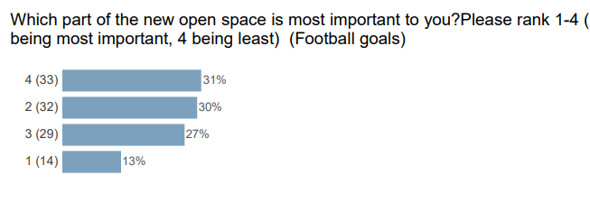
Which part of the new open space is most important to you?
Which part of the new open space is most important to you?

Slide 9
Which part of the new open space is most important to you?
Which part of the new open space is most important to you?

Slide 10
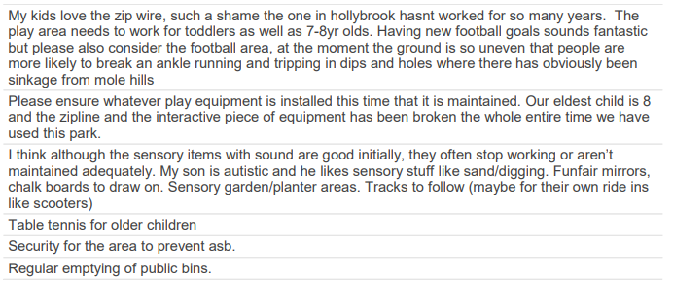
If you have any further comments, or something that you think might help meet the needs of community, please let us know here?

Slide 11
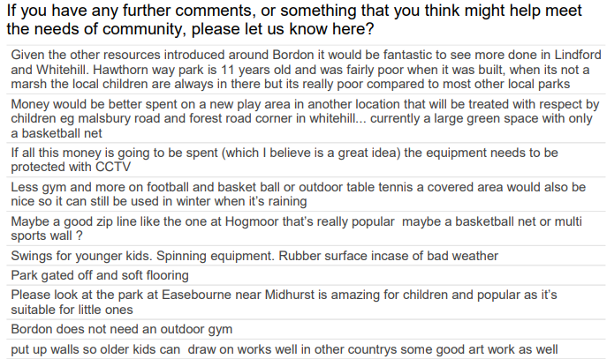
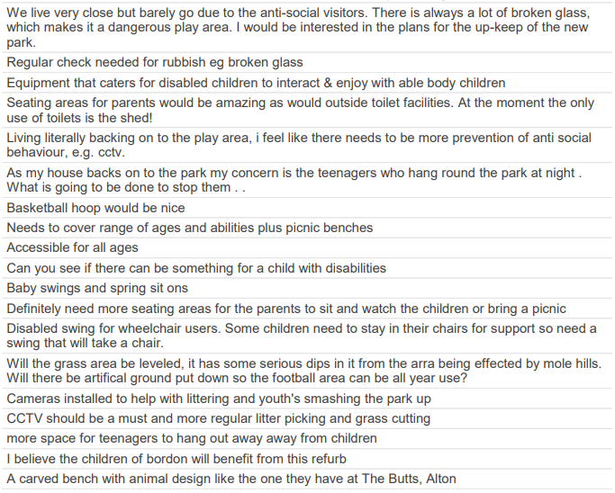
If you have any further comments, or something that you think might help meet the needs of community, please let us know here?

Slide 12
If you have any further comments, or something that you think might help meet the needs of community, please let us know here?

